Slide 1

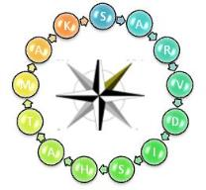



Quality Circle Project
Onkar Engine & Generator P Ltd
FY 2021-22

Slide 2
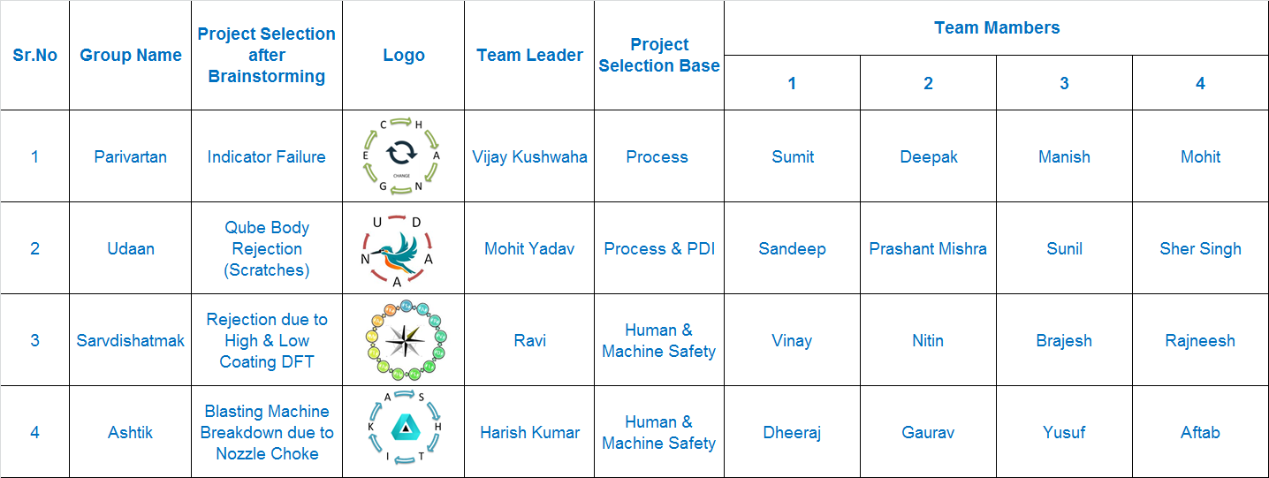
Quality Circle Team & Project Details (FY2021-22)

Slide 3
Project Gantt Chart

Slide 4
Project Topics completion

Slide 5
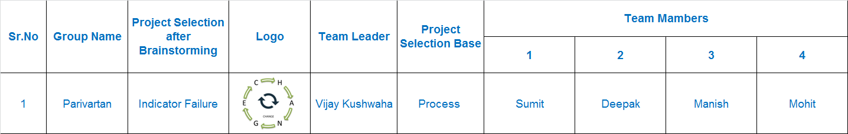
Project Overview : Parivartan

Slide 6

Team Interaction Details

Slide 7
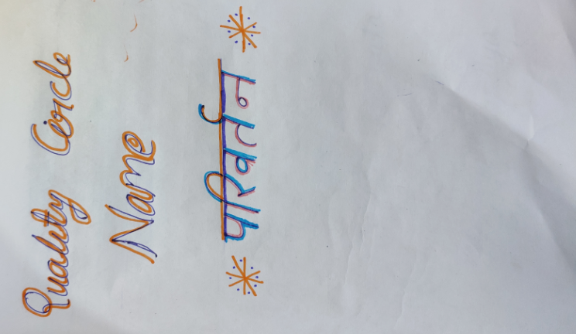
Project Details

Slide 8
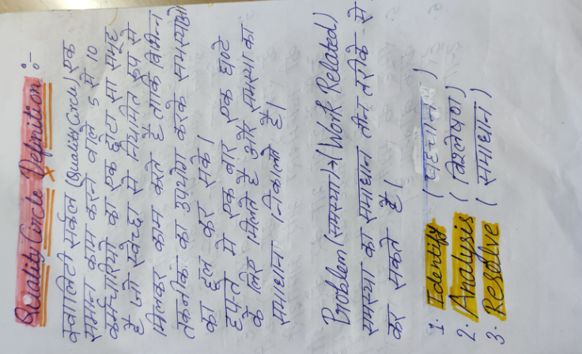
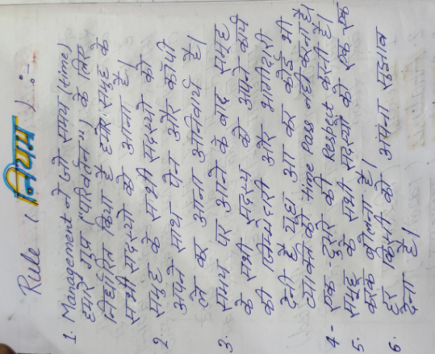
Definition & Rule

Slide 9
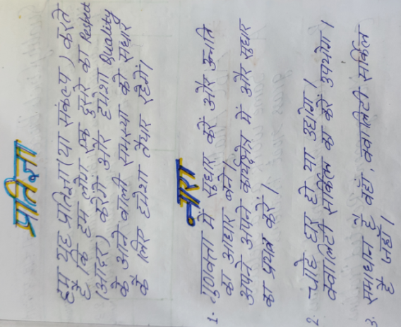
Team Pledge & Slogan

Slide 10
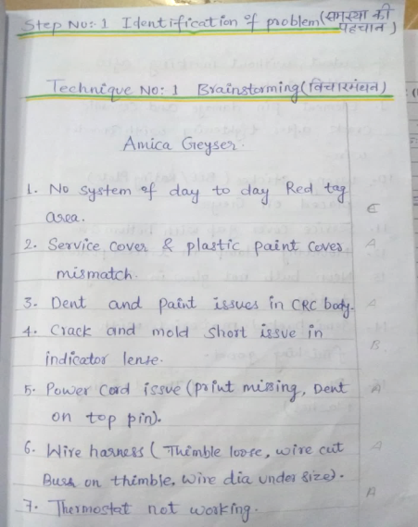
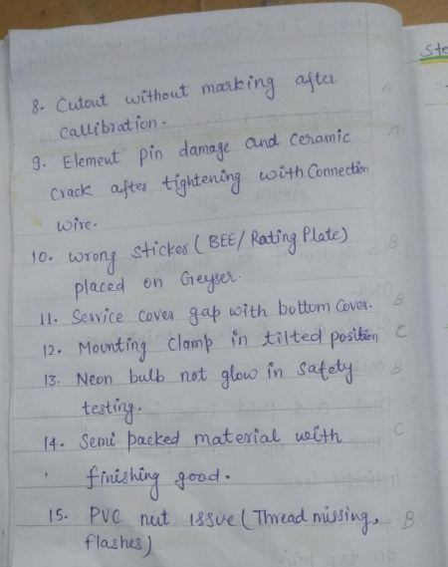
1. Identification of Problem
1. Brainstorming

Slide 11
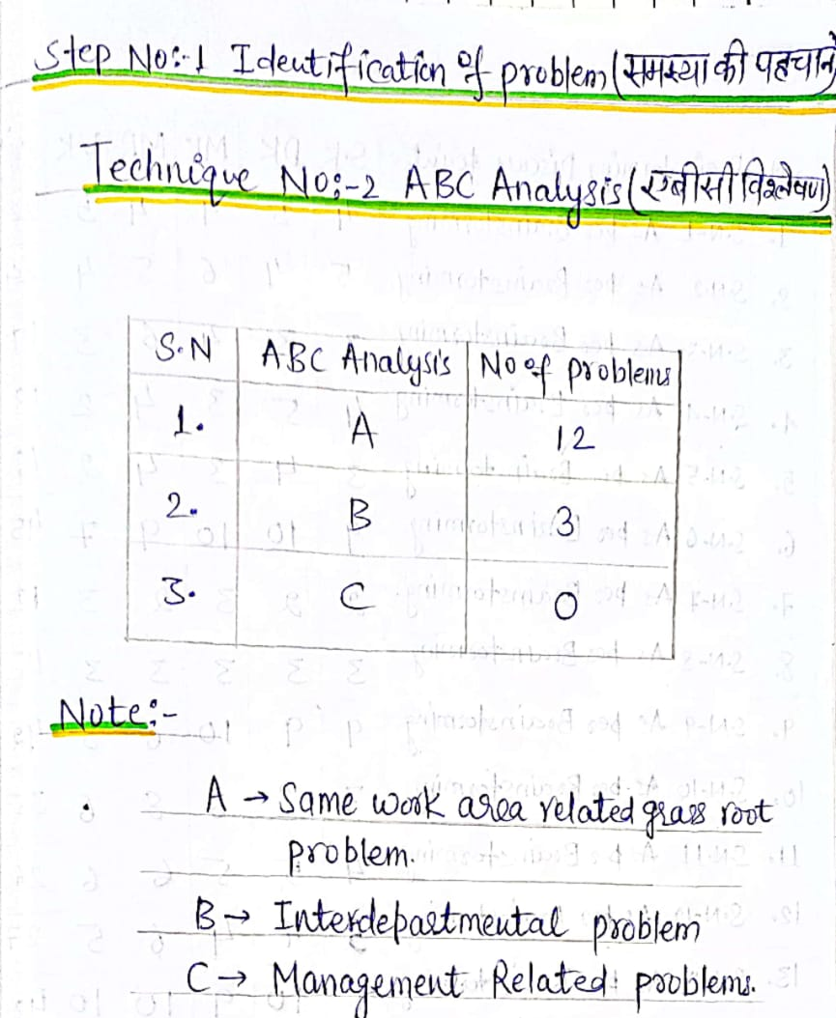
1. Identification of Problem
2. ABC Analysis

Slide 12

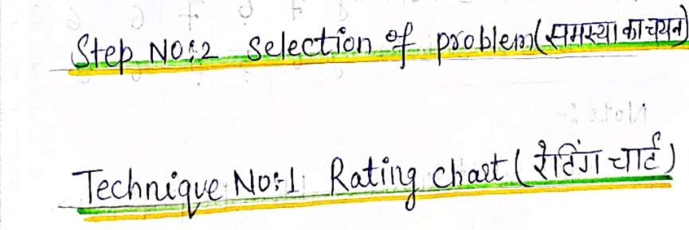
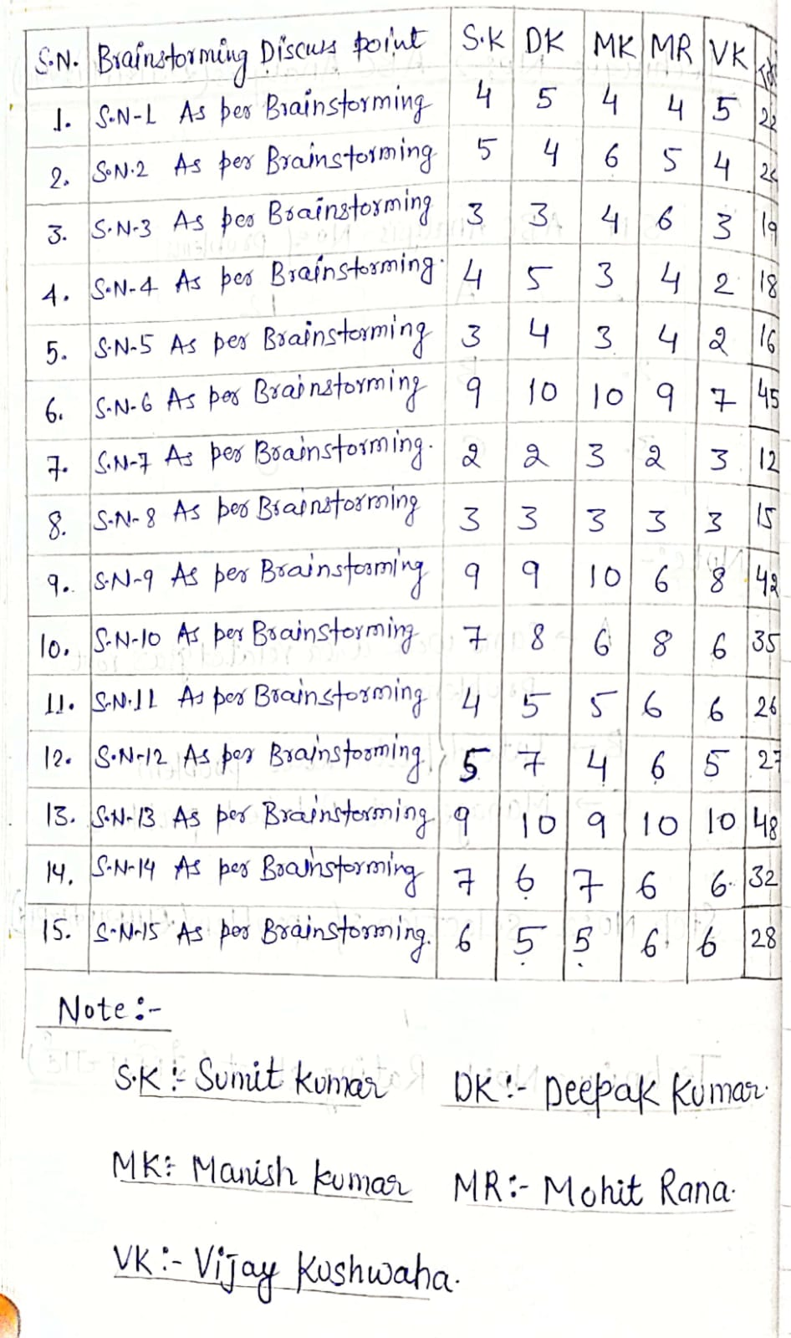
2. Selection of Problem
1. Rating Chart

Slide 13
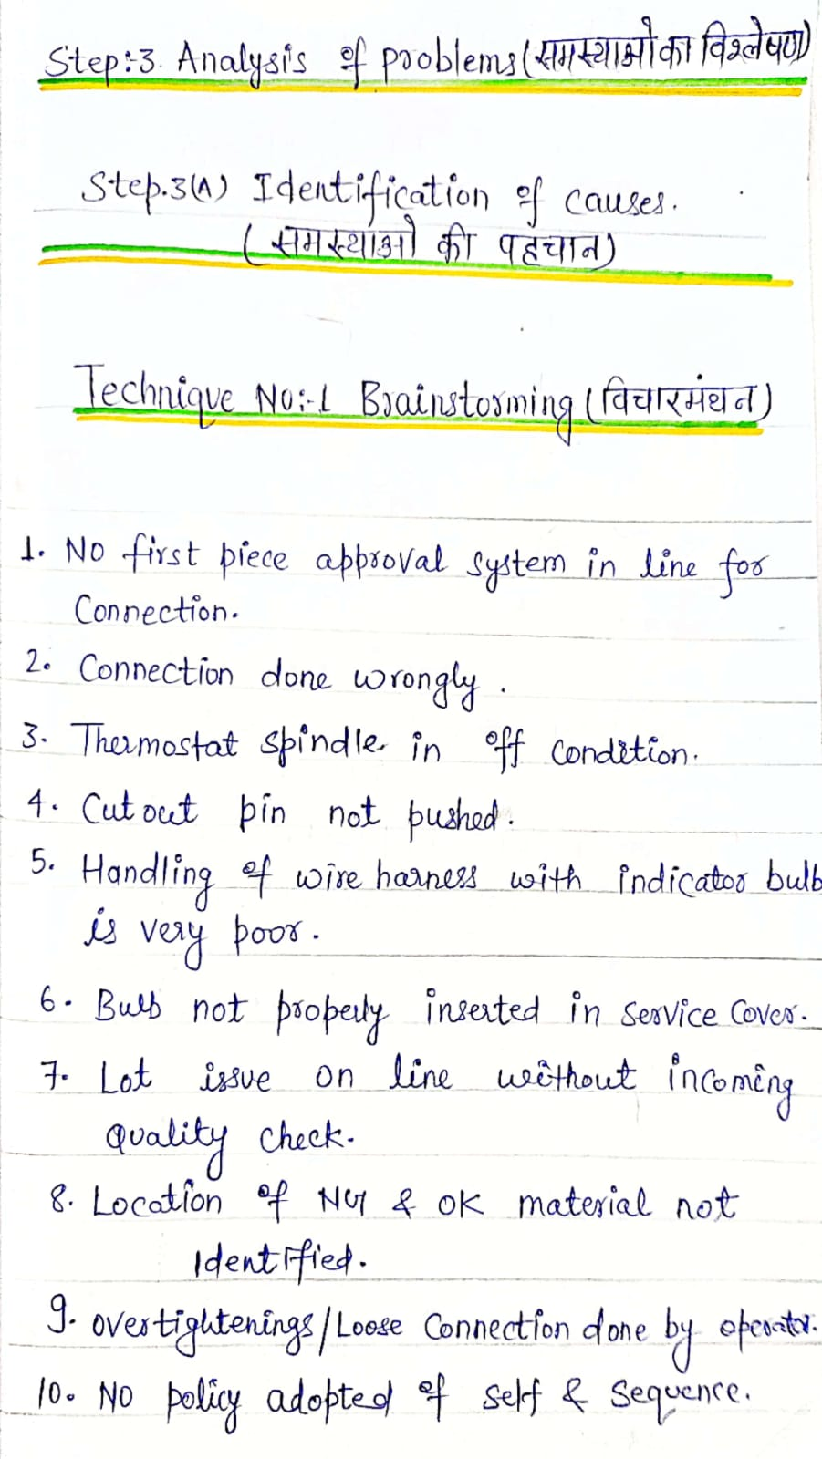
3a. Identification of Causes
1. Brainstorming

Slide 14
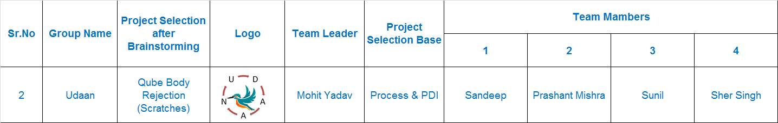
Project Overview : Udaan

Slide 15

Team Interaction Details

Slide 16

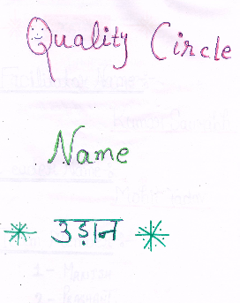
Project Details

Slide 17
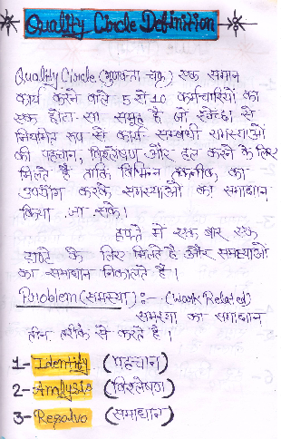
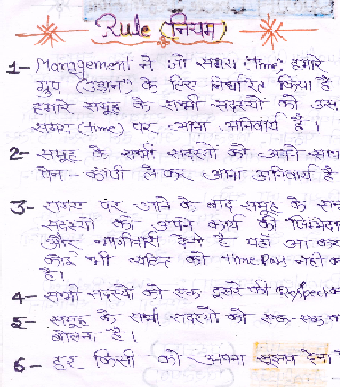
Definition & Rule

Slide 18
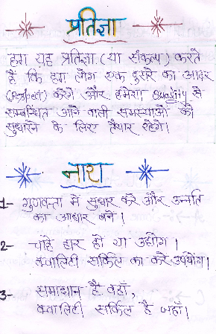
Team Pledge & Slogan

Slide 19
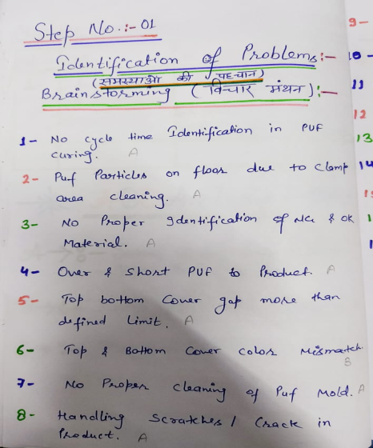
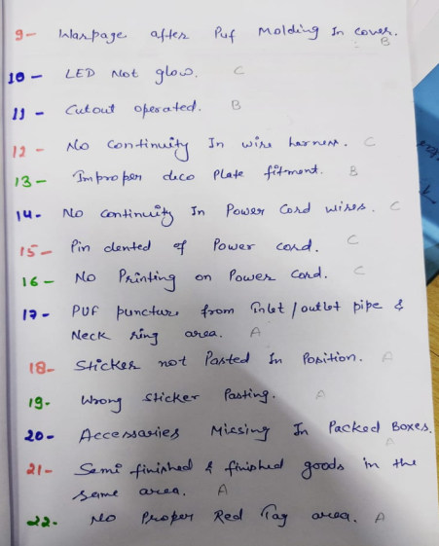
1. Identification of Problem
1. Brainstorming
2. ABC Analysis

Slide 20
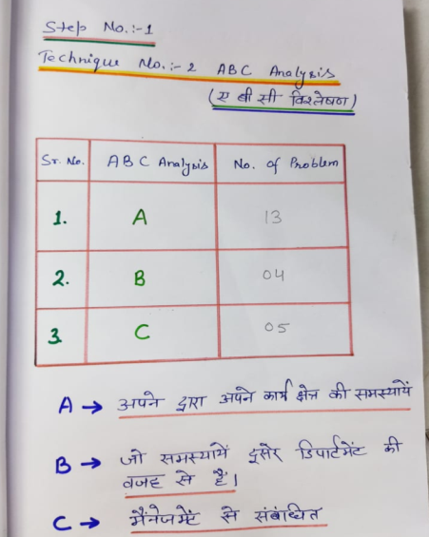
1. Identification of Problem
2. ABC Analysis

Slide 21
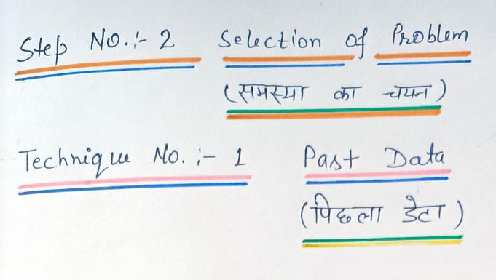
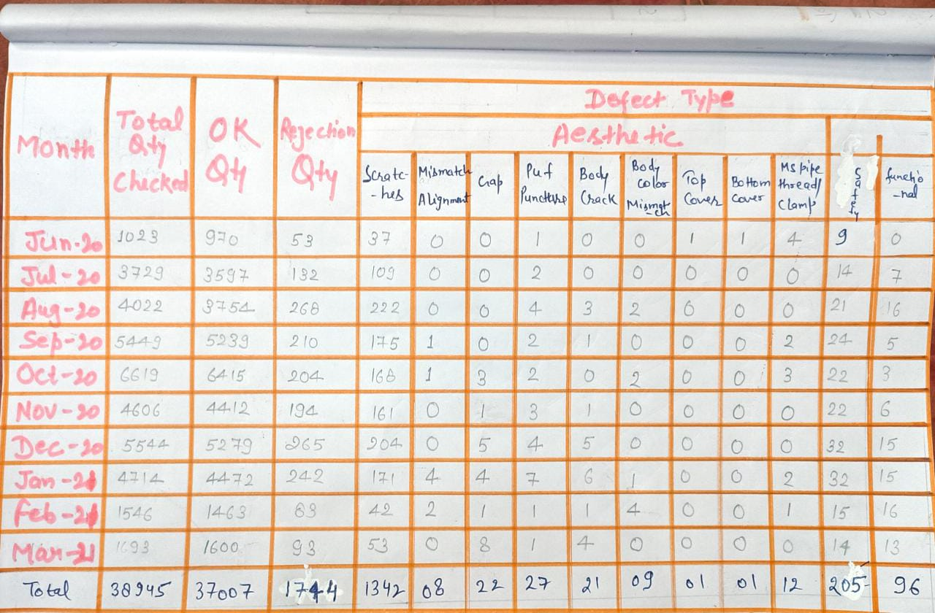
2. Selection of Problem
1. Past Data

Slide 22
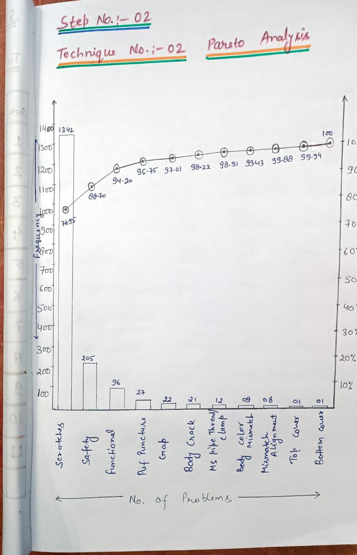
2. Selection of Problem
1. Pareto Analysis

Slide 23
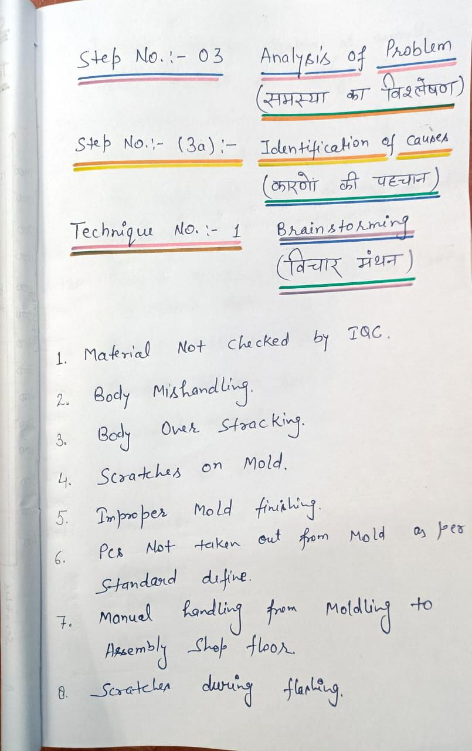
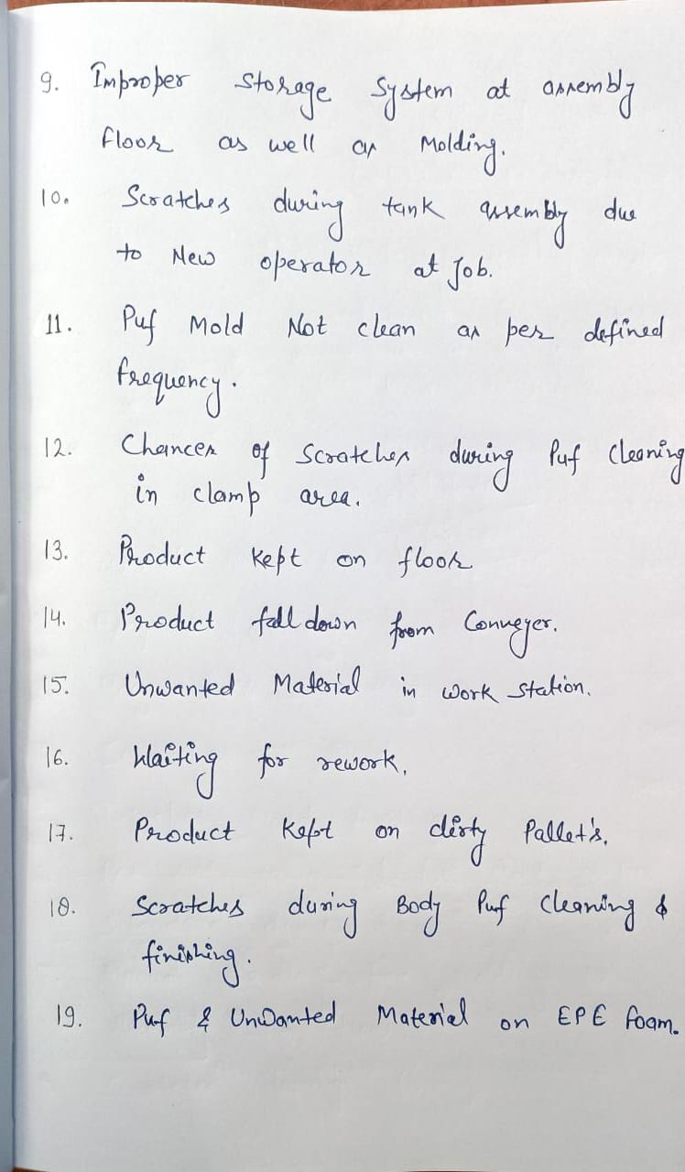
3a. Identification of Causes
1. Brainstorming

Slide 24
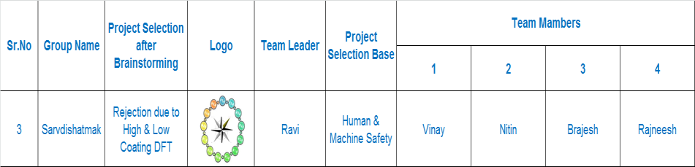
Project Overview : Sarvdishatmak

Slide 25

Team Interaction Details

Slide 26
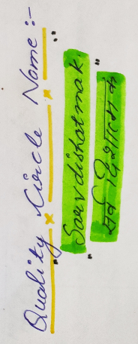

Project Details

Slide 27
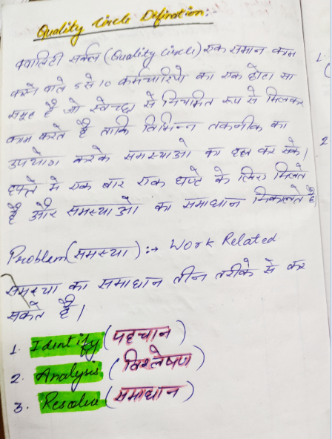
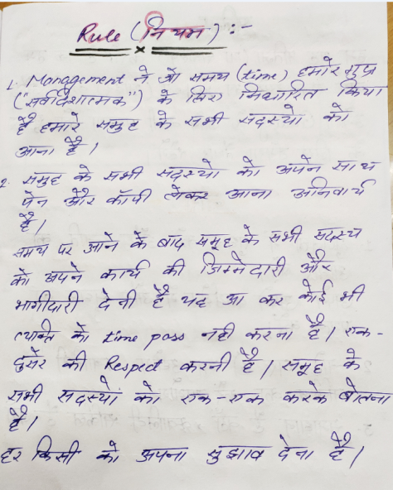
Definition & Rule

Slide 28
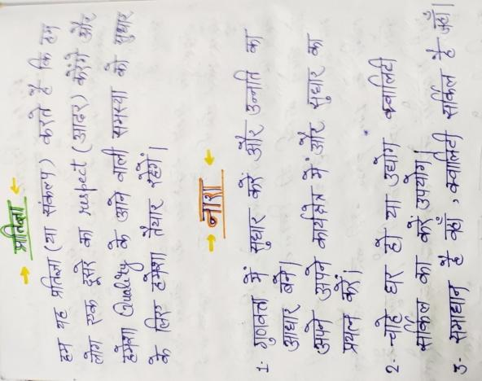
Team Pledge & Slogan

Slide 29
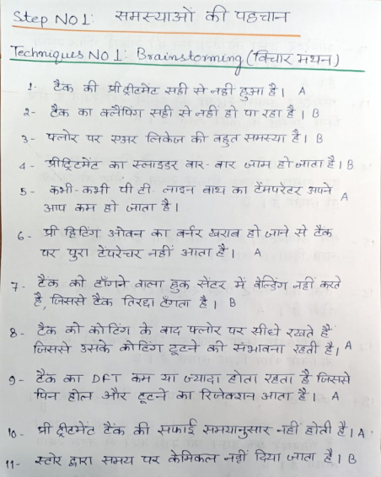
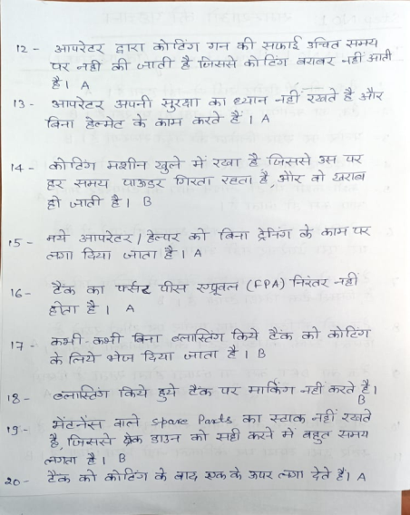
1. Identification of Problem
1. Brainstorming

Slide 30
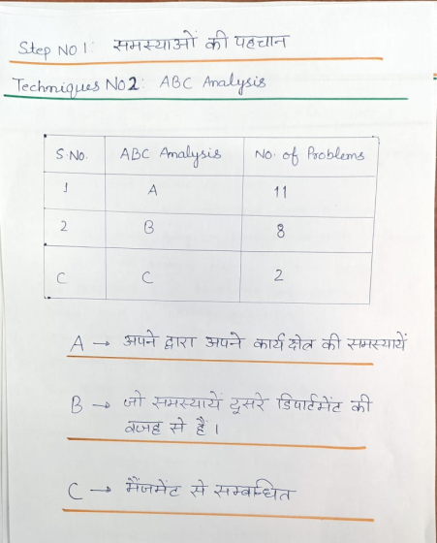
1. Identification of Problem
2. ABC Analysis

Slide 31
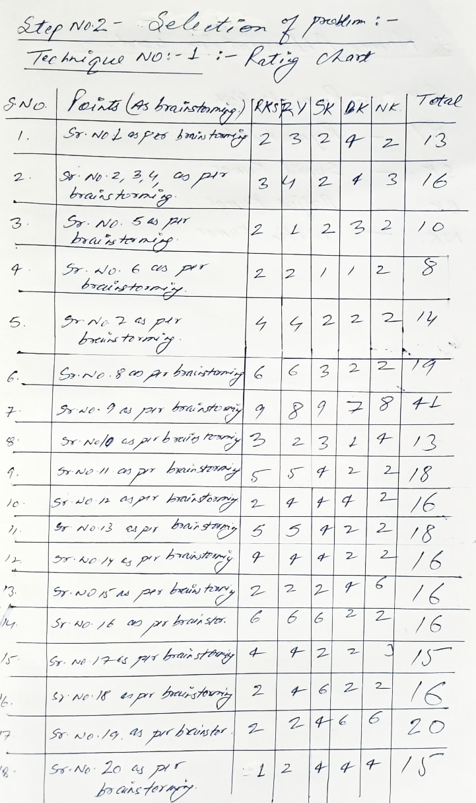
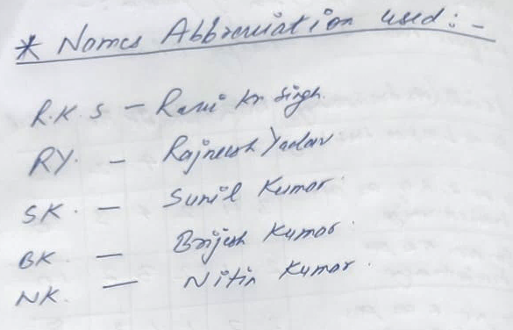
2. Selection of Problem
1. Rating Chart

Slide 32
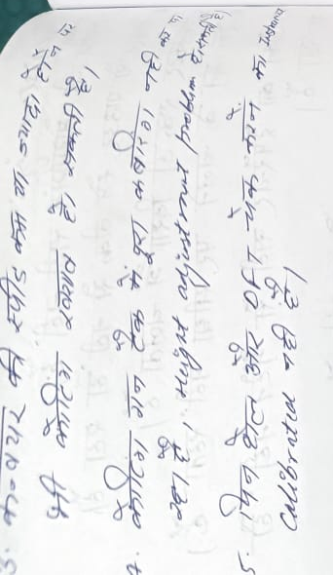
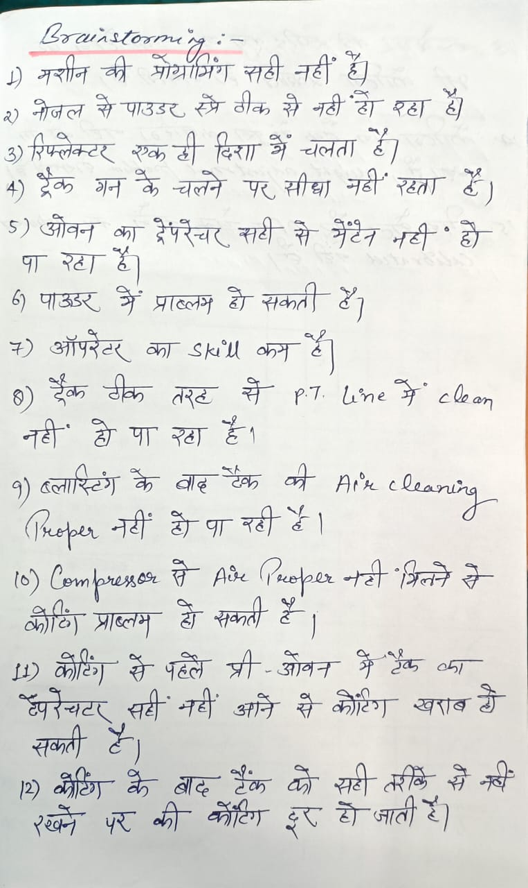
3a. Identification of Causes
1. Brainstorming

Slide 33
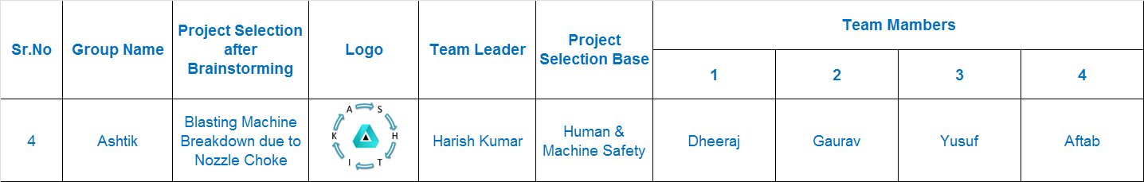
Project Overview : Ashtik

Slide 34

Team Interaction Details

Slide 35

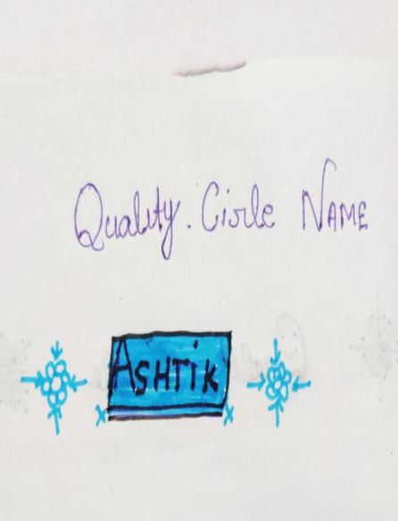
Project Details

Slide 36
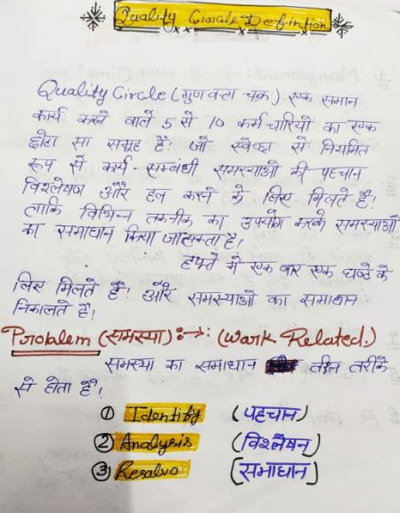
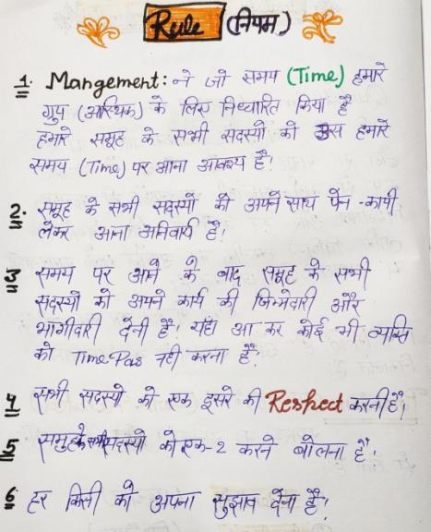
Definition & Rule

Slide 37
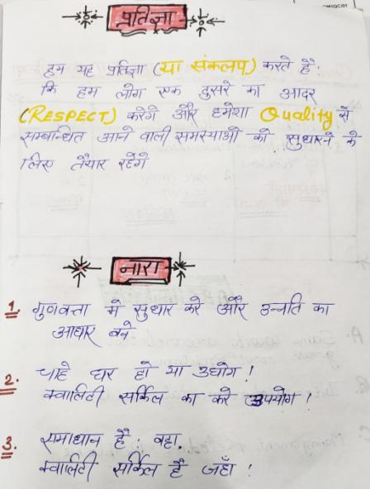
Team Pledge & Slogan

Slide 38
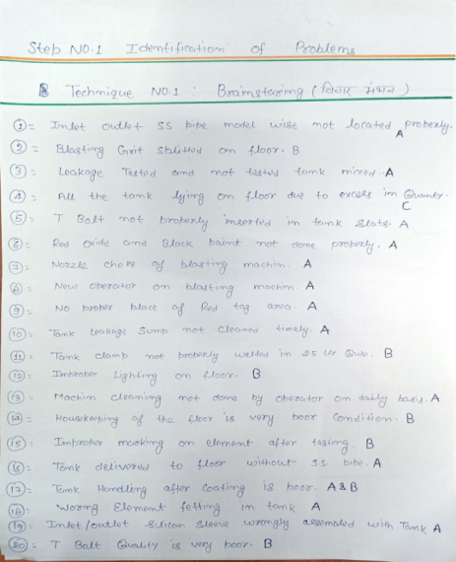
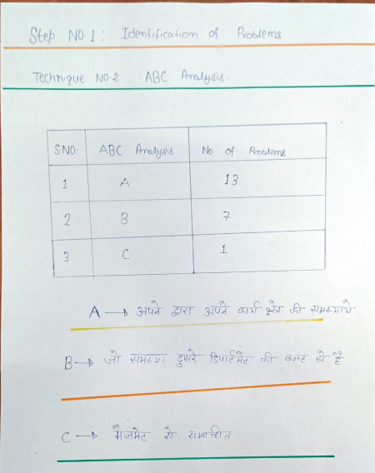
1. Identification of Problem
1. Brainstorming
2. ABC Analysis

Slide 39
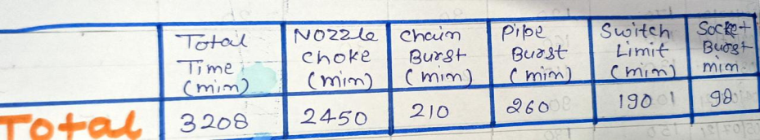
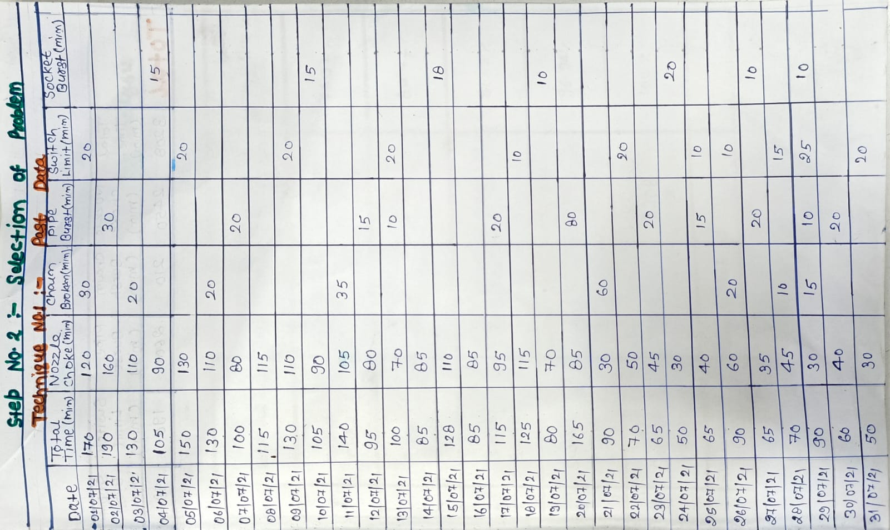
2. Selection of Problem
1. Past Data

Slide 40
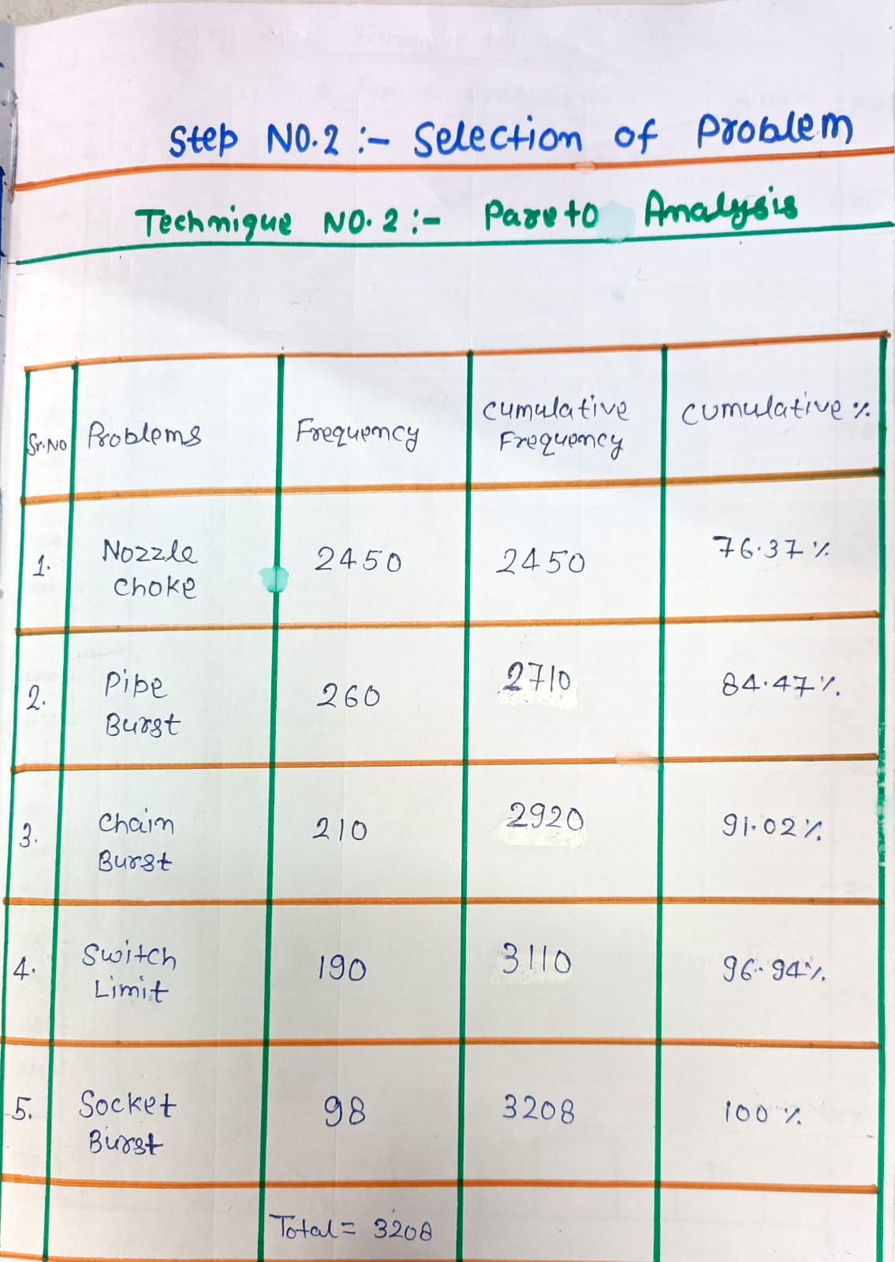
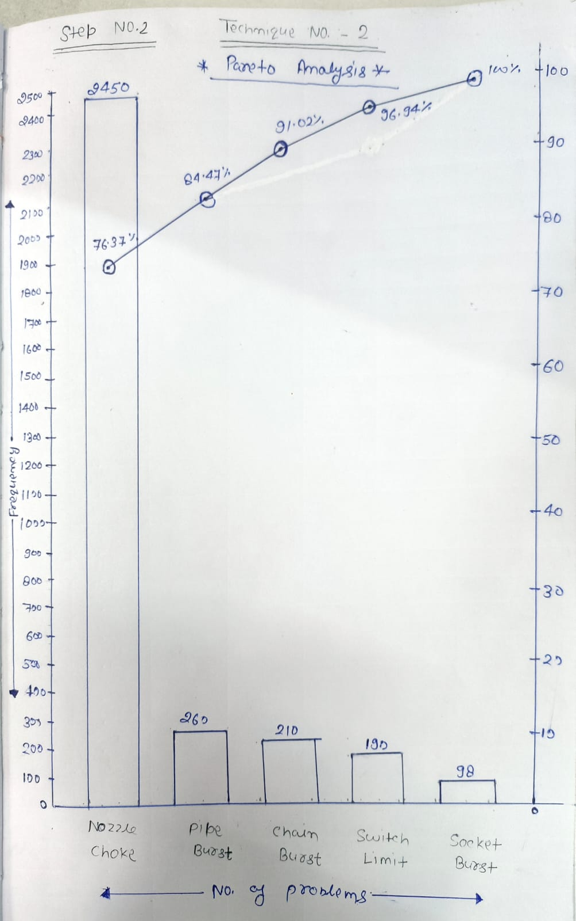
2. Selection of Problem
Pareto Chart

Slide 41
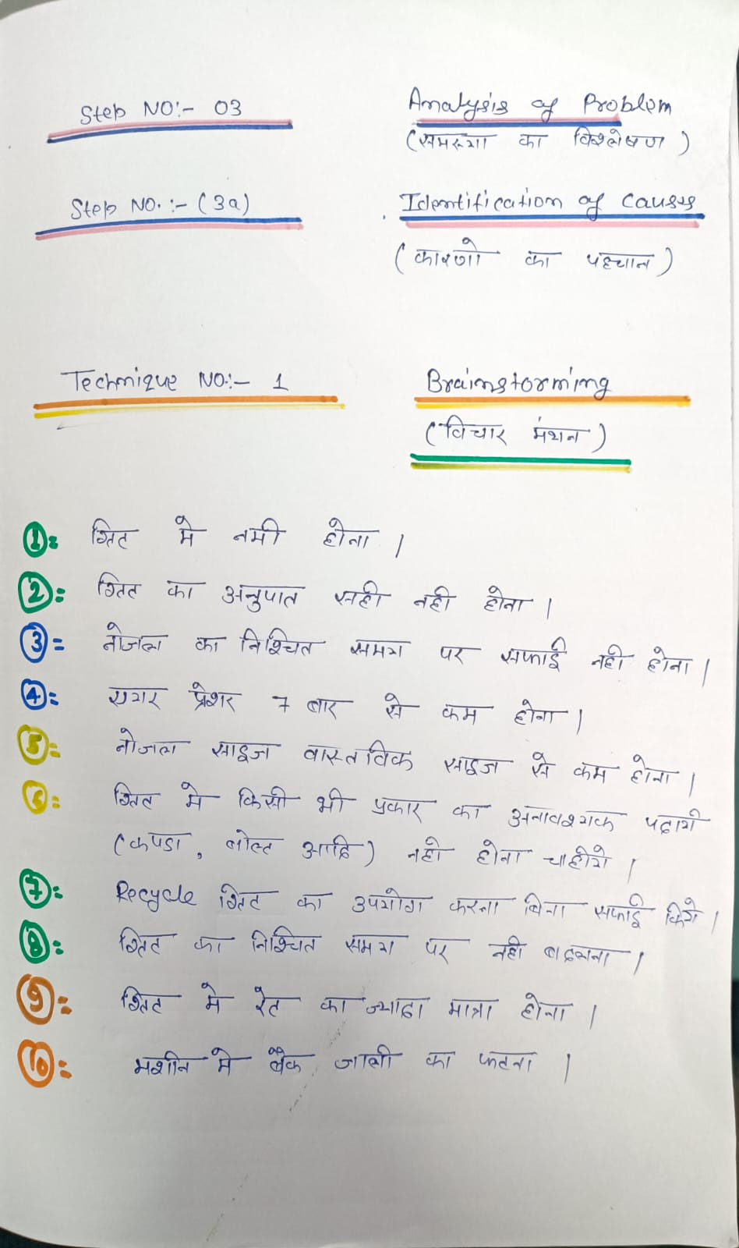
3a. Identification of Causes
1. Brainstorming

Slide 42
THANK YOU SIR

